Slide 1

CHINOOK MUSIC STORE
Roshni Kumari
5-10-2024

Slide 2
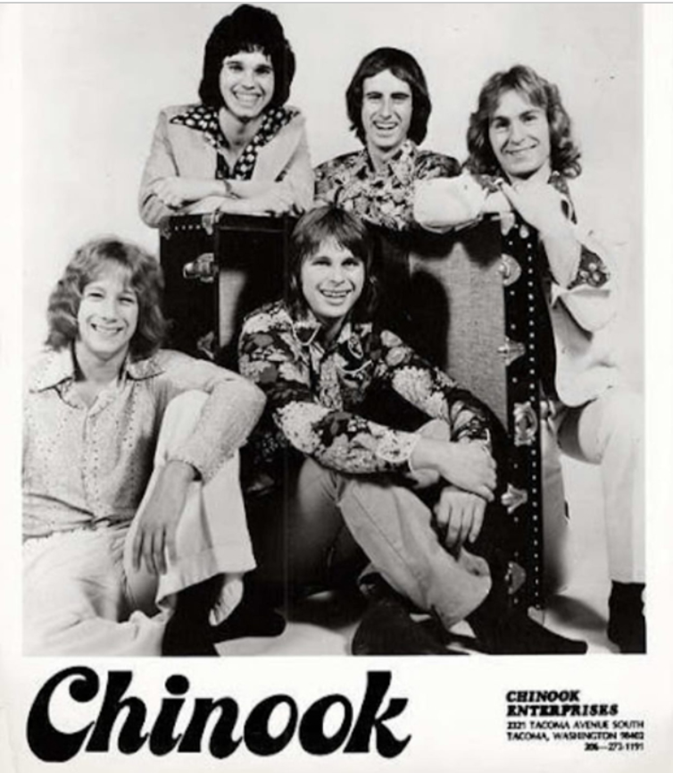
Introduction
Chinook music refers to a genre or style of Indigenous music that is influenced by the cultural practices and traditions of the Chinook people, a Native American tribe primarily located in the Pacific Northwest region of the United States.
The Chinook database was created by Luis Rocha.

Slide 3

Objectives
Problem Statement
To facilitate data-driven growth, our analysis will focus on key music store trends, including customer demographics, purchasing patterns, and churn rates.
At Chinook, my objective is to extract valuable insights from music sales data by solving Objective and Subjective questions that are given, and also guiding strategic initiatives in the physical music market.

Slide 4

Chinook Music Database Overview
The Chinook music database consists of 11 tables: - Artists, Albums, Customers, Employees, Genres, Invoices, Invoice_line, Media_type, Playlist, Playlist_track, and Track.
The total number is customers available at Chinook Music Store is: - 59
Chinook music stores are explored in 24 countries.
Chinook music store has a total of 186 Albums, 16 Genres, a total of 157 Tracks, 130 Artists, and 18 Playlists.
Chinook have done 4.71k total Revenue.

Slide 5

Methodology
Data Cleaning: -
Handling missing data elements to improve data quality and reliability.
Performed data duplication analysis for accuracy.
Schema developed by introducing foreign key relationships between tables.
Deriving insights: -
Leveraging CTEs, JOINS, Subqueries, and WINDOW Functions.
Analytics: -
Visualized data in a whole new way using charts and slicers, revealing trends and patterns.
A Power BI dashboard was developed to visualize data correlations and facilitate in-depth analysis.

Slide 6
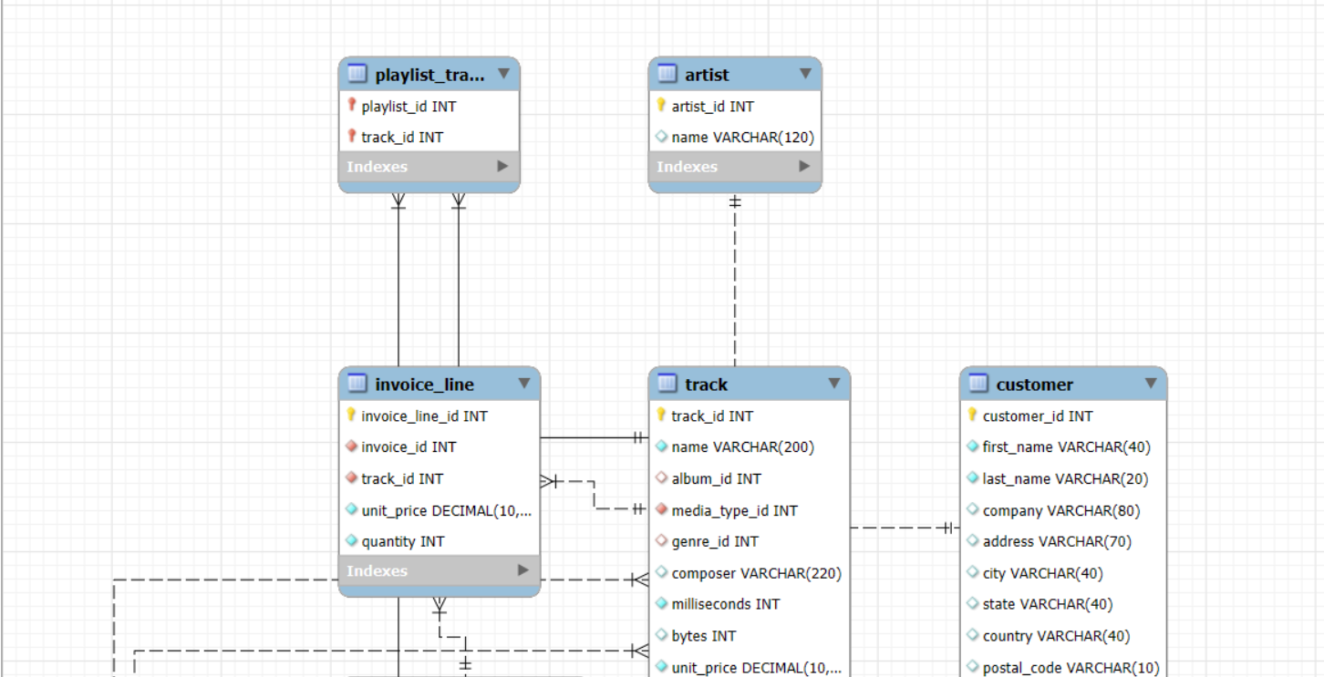
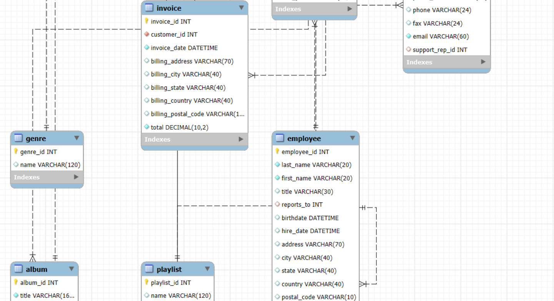

ER Diagram
An ER Diagram was developed by defining relationships between tables using foreign keys, and visualizing the database schema.

Slide 7



INSIGHTS AND RECOMMENDATIONS

Slide 8
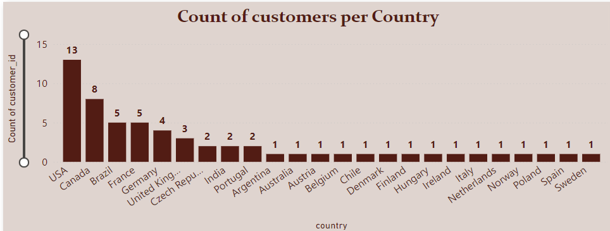
Total Customers in each country
USA has the highest total number of customers at 13.
After the USA, Canada is 2nd top country of the number of Chinook customers is 8.
Argentina, Australia, Austria, Belgium, Chile, Denmark, Finland, Hungary, Ireland, Italy, Netherlands, Norway, Poland, Spain, and Sweden have only 1 customer available as the minimum number of customers.

Slide 9
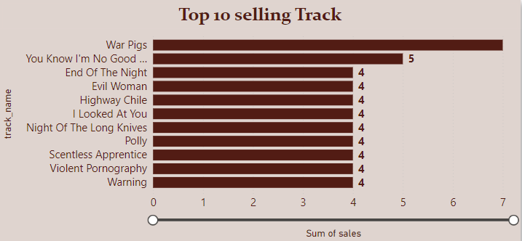
Top 10 selling Tracks in the USA
In the USA the top 10 tracks include War Pigs, You Know I’m No Good(feat Ghostface Killah), End of the Night, Evil Woman, highway Chile, and so on.
War Pigs is the top Track in the USA by selling with 7.
You Know I’m No Good(feat Ghostface Killah) is the 2nd top Track which customers purchased most with 5.

Slide 10
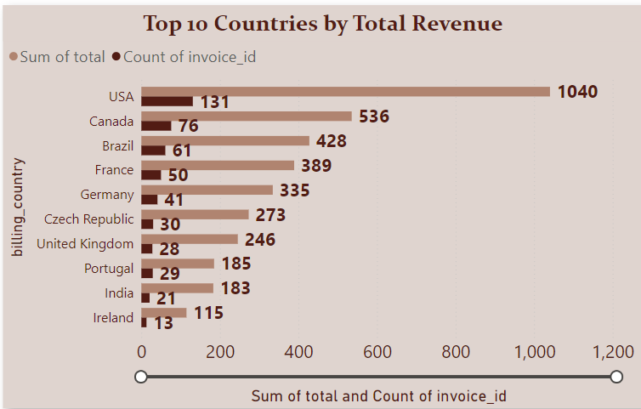
Top 10 countries by Total Revenue and purchase frequency
Top 5 Countries by Total Revenue:
Canada is 2nd top country - $536
USA is top most country by total revenue - $1040
Brazil - $428
Germany - $335
France - $389
Top 5 Countries by Number of Invoices:
Canada has frequency of purchase - 76
Purchase frequency of Brazil - 61
Germany - 41
USA has highest purchase frequency - 131
France – 50

Slide 11
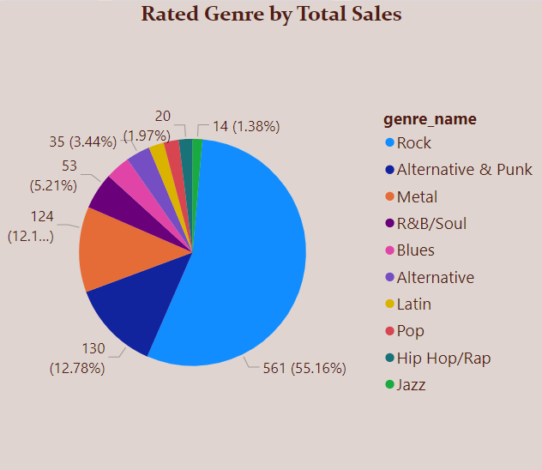
Top 10 selling Genre in USA
Top 10 selling genres in the USA are Rock, Metal, Alternative & Punk, Latin, R&B/Soul, Blues, and so on.
Rock is the top genre Purchased by customers in the USA with 561.
The 2nd top genre in the USA is Alternative & Punk as 130
Metal is the 3rd top genre in the USA with 124.

Slide 12
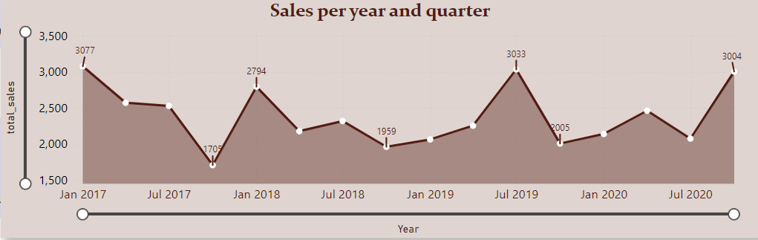
Fluctuation in Total Sales per year and quarter
The highest sales Chinook music store gained in 2017 quarter 1 was 3076.92k.
After that in July 2019 Quarter 3 gained 3033.36k.
In July 2017 quarter 4, the lowest total sales gained by Chinook Music was 1704.78k.

Slide 13
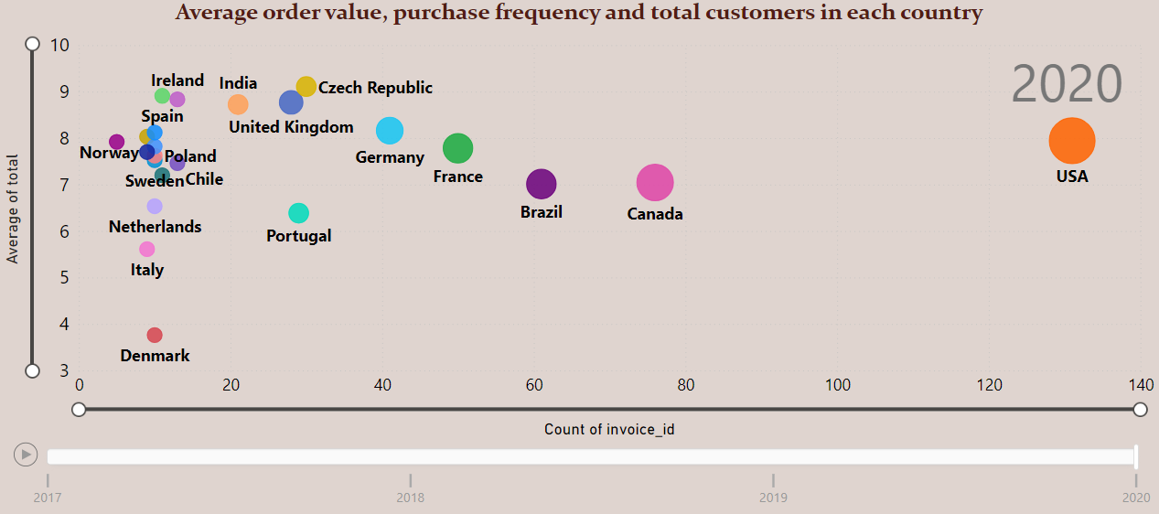
Relation between average order value, frequency, and total customers in each country per year.
This bubble chart shows the relationship between average order values, purchase frequency, and total number of customers in each country per year.
After analysis got to know that the USA is the top country in AOV, purchase frequency, and number of customers in every year. (frequency- 131, AOV- 7.94, and total customers - 13).
Canada is the 2nd
Canada: - frequency- 76, AOV- 7.06, and total customers – 8.

Slide 14
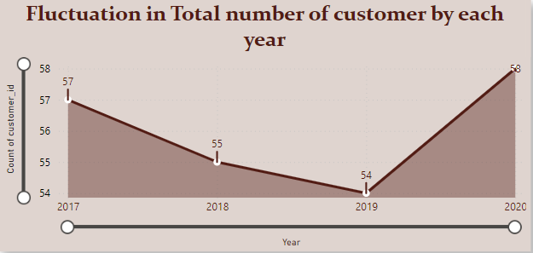
Fluctuation in number of customers per year
In 2020 the overall number of customers available was 58 which is the highest.
In 2019 the lowest number of customers was 54.

Slide 15
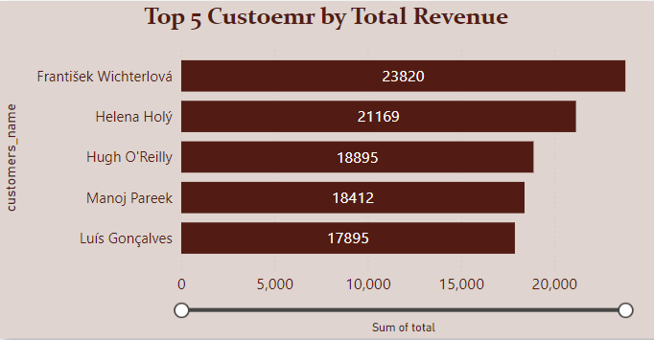
Top 5 Customers by total revenue
Top 5 Customers are Frantisek Wichterlova, Helena Holy, Hugh O'Reilly, Manoj Pareek, and Luis Goncalves.
Frantisek Wichterlova Spending High amount as 23820k
Helena Holy has paid 2nd highest amount which is 21169.

Slide 16
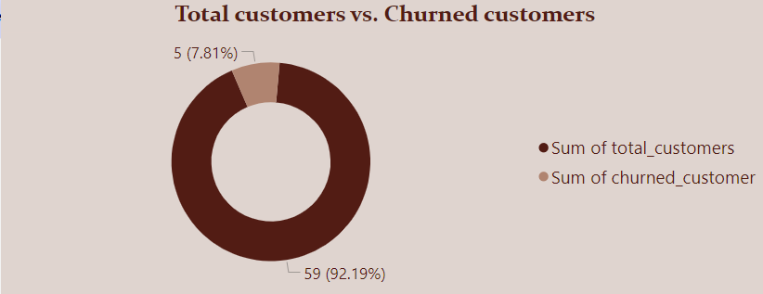
Total Churned Customers
A total of 59 customers are available in the Chinook Music store.
Total Churned Customers are 5.
So, the remaining number of customers is 54.

Slide 17
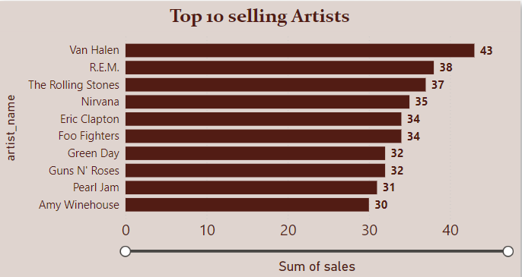
Top 10 selling Artists in USA
According to sales data, the top 5 best-selling artists in the USA are Van Halen, R.E.M., The Rolling Stones, Nirvana, and Eric Clapton.
Van Halen is the top Artist purchased by customers with 43.
R.E.M. ranks 2nd among the best-selling artists, with an impressive 38 million records sold.
The Rolling Stones's sales figures reveal an impressive 38 million units sold, placing them 3rd among the best-selling artists.

Slide 18
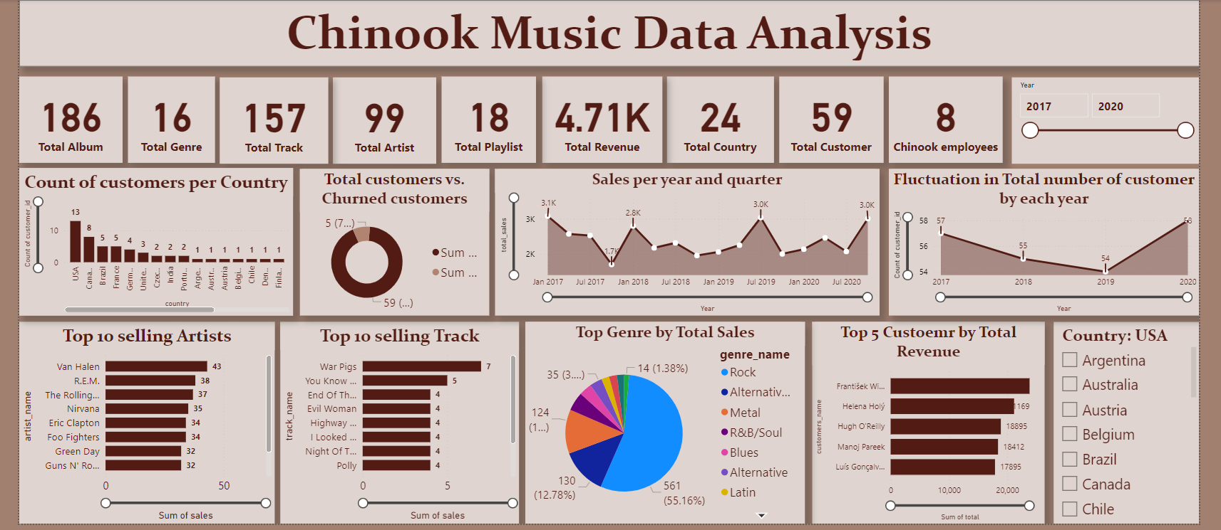
Visual Insights Dashboard

Slide 19

Outcome
I have facilitated data-driven growth, our analysis will focus on key music store trends, including customer demographics, purchasing patterns, and churn rates.
At Chinook, we successfully extracted valuable insights from music sales data by addressing specific objective and subjective questions, informing strategic decisions to drive growth in the physical music market.

Slide 20

Thanking you

